Slide 1






Event Management System Using Python
Team 4 (Members):
Shyam Singh (frontend and Backend)
Kummari Sreekanth (frontend and Backend)
Sharan M A (frontend and Backend)

Slide 2

Project Abstract
The Event Management System is a web-based application developed using Django.
Aimed at facilitating the creation, booking, and management of events.
Provides users with a streamlined interface to manage various event-related activities:
User registration
Booking events
Providing feedback
Developed as part of an internship project at Infosys Springboard.
Emphasizes user experience, security, and efficiency.
Key functionalities include:
User authentication
Event management
Booking system
Contact form for inquiries

Slide 3
Technologies and Requirements
Technologies Used:
Django (Python)
Bootstrap (CSS Framework)
SQLite (Database)
HTML/CSS
JavaScript
Requirements:
Python 3.8+
Django 3.2+
Internet Connection
Web Browser (Chrome, Firefox, etc.)

Slide 4
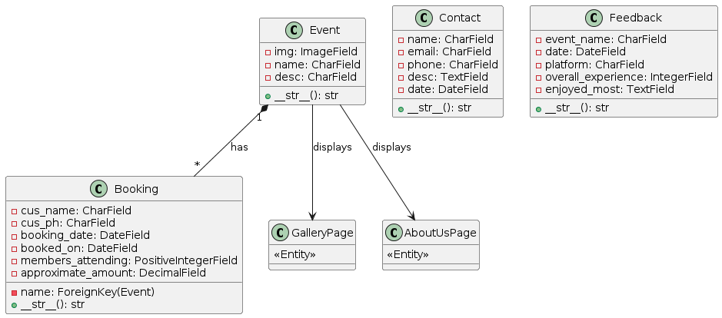
Event Management System Class Diagram

Slide 5
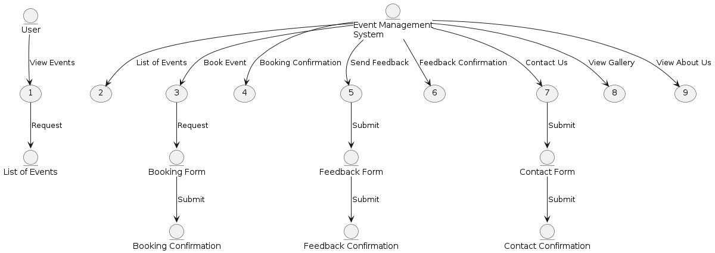
Event Management System Data Flow Diagram (DFD)

Slide 6
Project Features
User Registration: Allows users to create accounts and log in securely.
Event Management: Enables the creation and management of events by authenticated users.
Booking System: Provides a booking interface for users to book events and view their bookings.
Contact Form: A form for users to send inquiries and feedback.

Slide 7
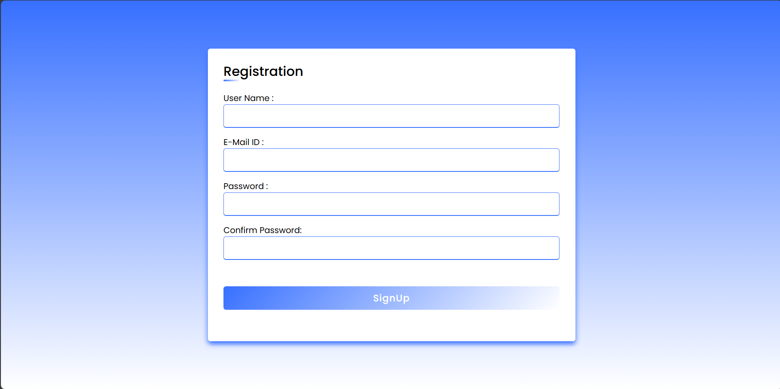
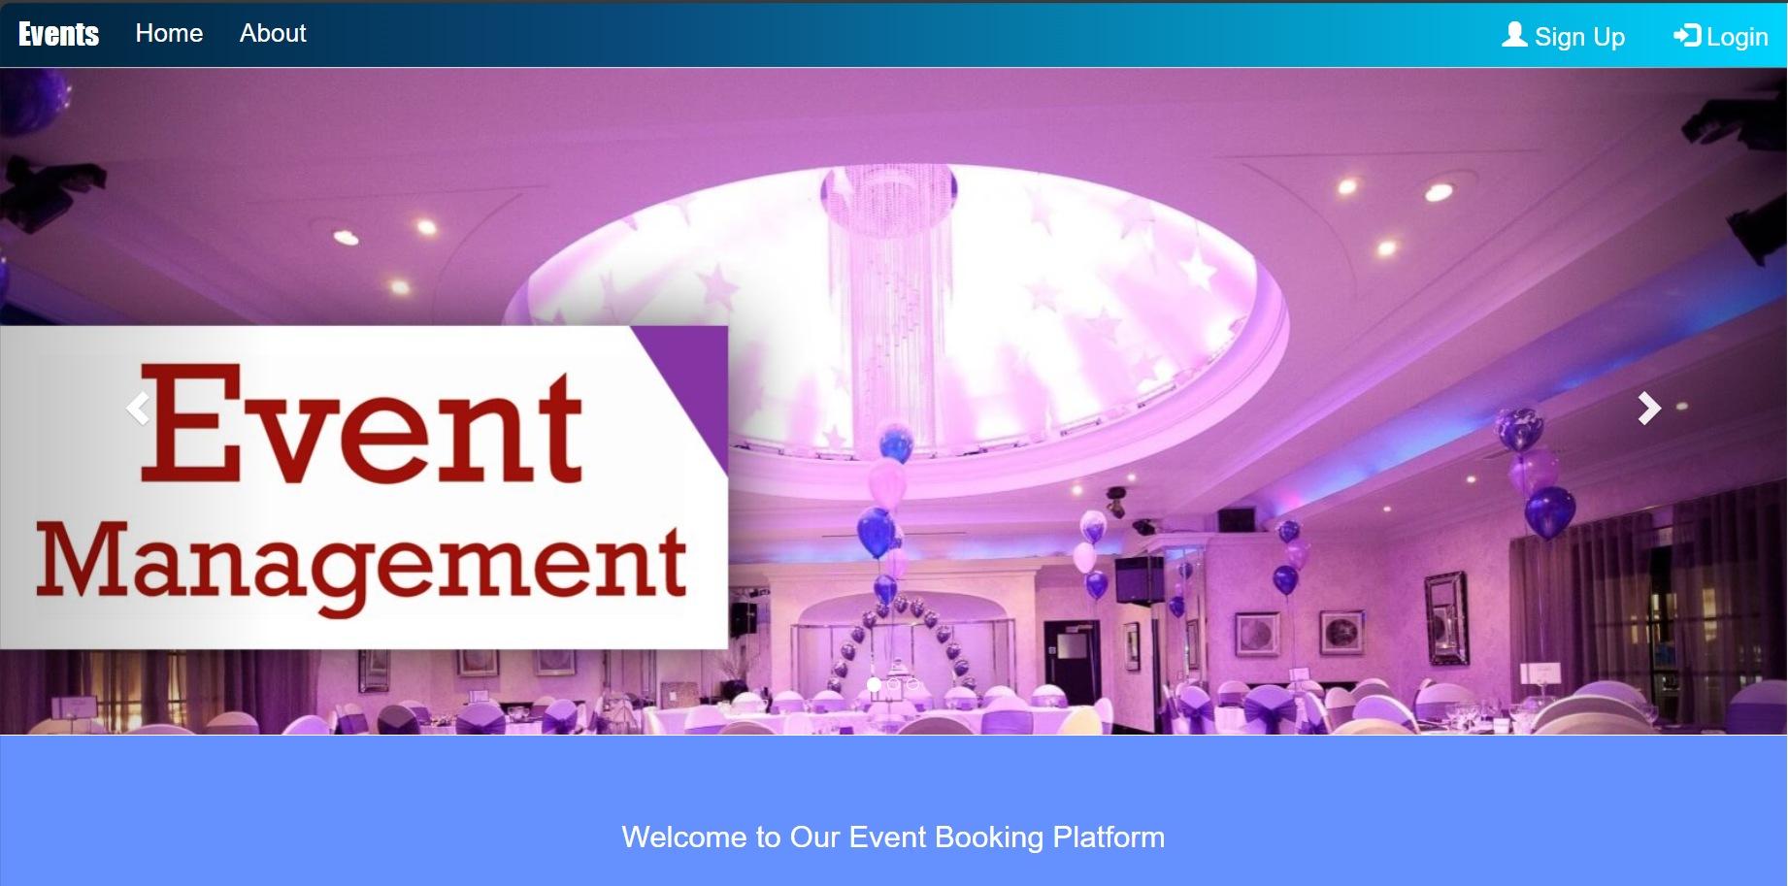
Snapshots of the Projects:
Registration Page
Home Page

Slide 8
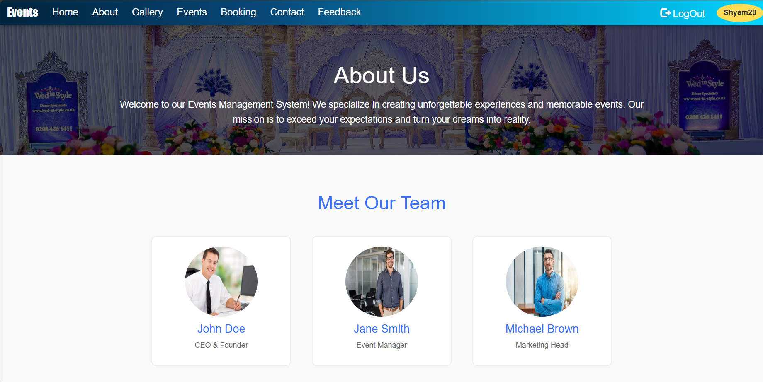
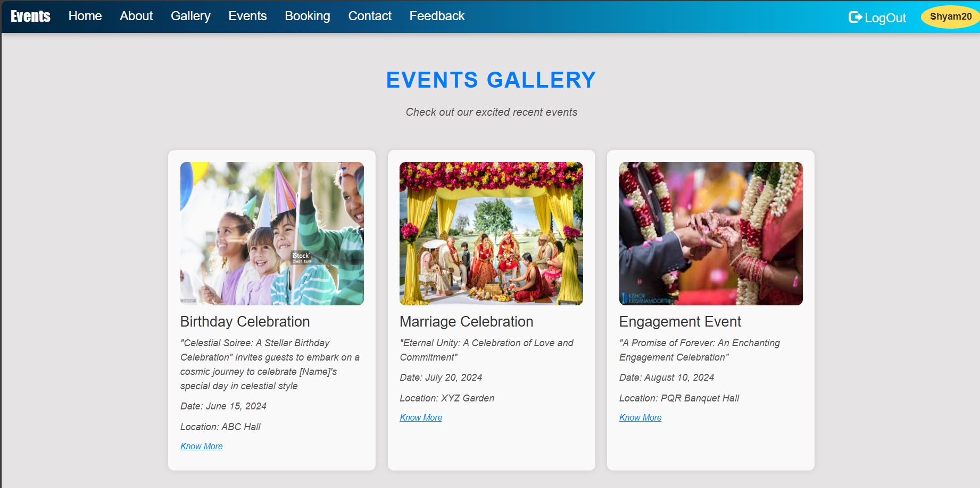
Snapshots of the Projects:
About us Page
Gallery Page

Slide 9
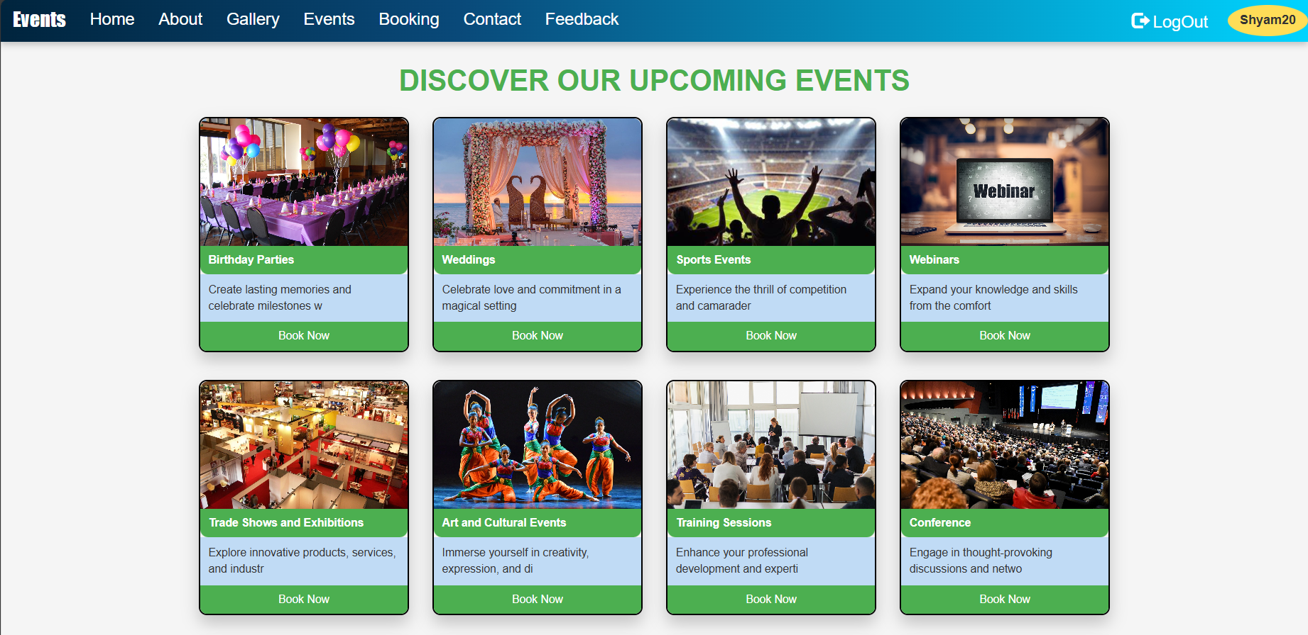
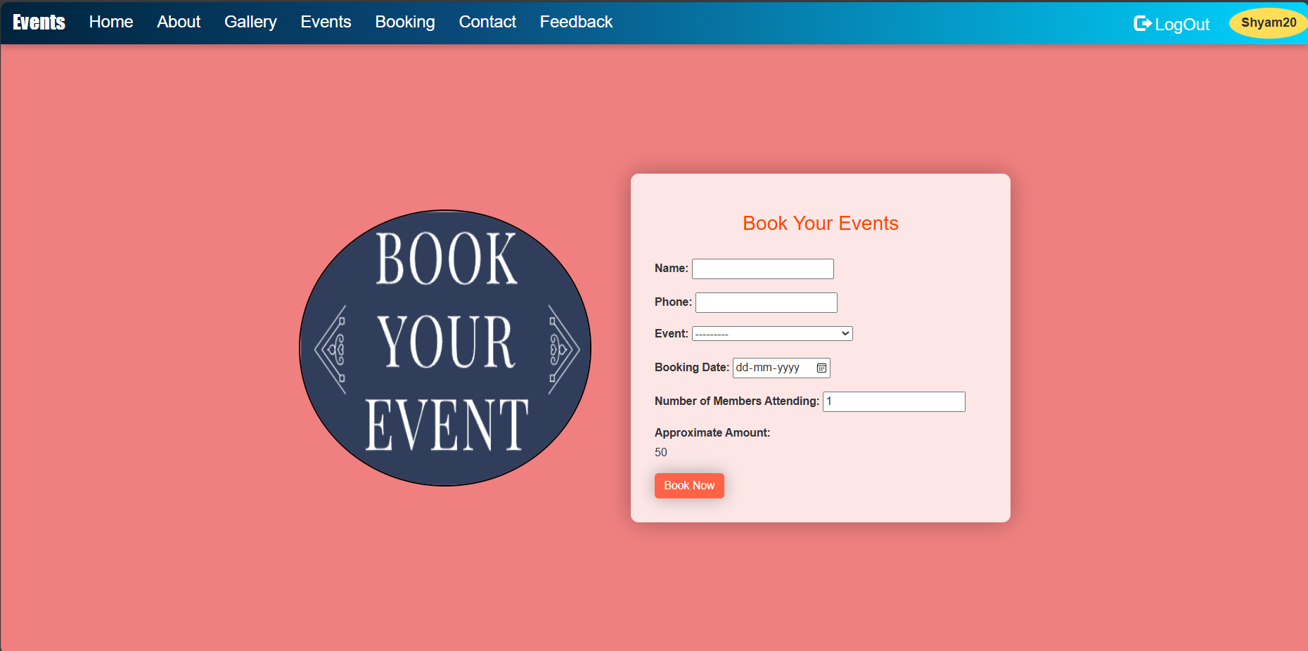
Snapshots of the Projects:
Events Page
Booking Page

Slide 10
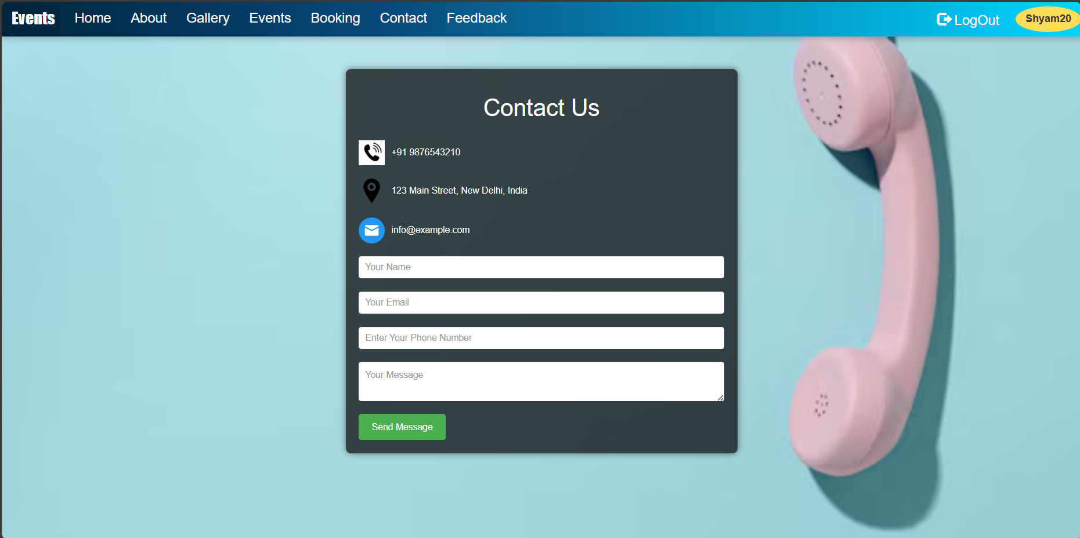
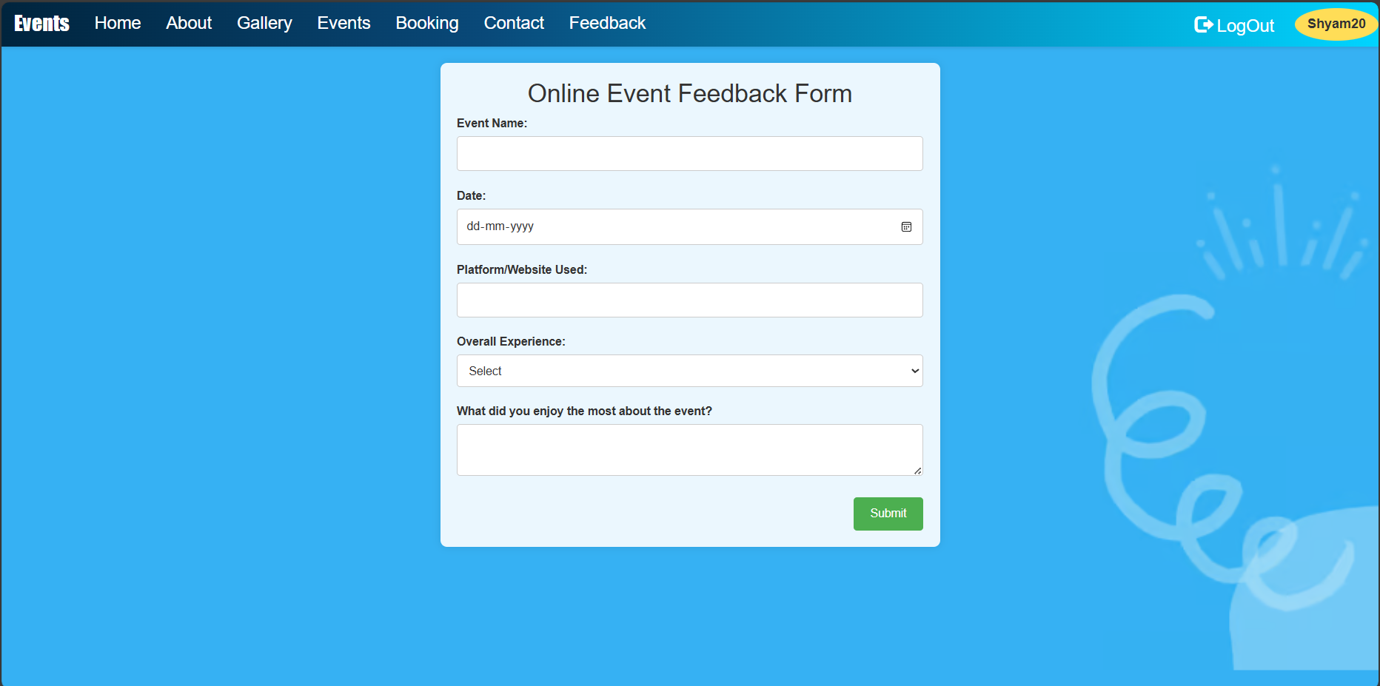
Snapshots of the Projects:
Contact Page
FeedBack Page

Slide 11
Conclusions and Future Scope
The Event Management System successfully integrates key functionalities required for efficient event management. Github link
The use of Django as the backend framework ensures a robust and scalable application.
The project emphasizes user experience through a clean and intuitive interface.
Deployment on PythonAnywhere demonstrates the application's readiness for real-world use. Live Deployment link
Future enhancements can include additional features such as payment integration and detailed reporting.

